Slide 1

Factoring trinomials
$${Ax}^{2}+Bx+C$$

Slide 2
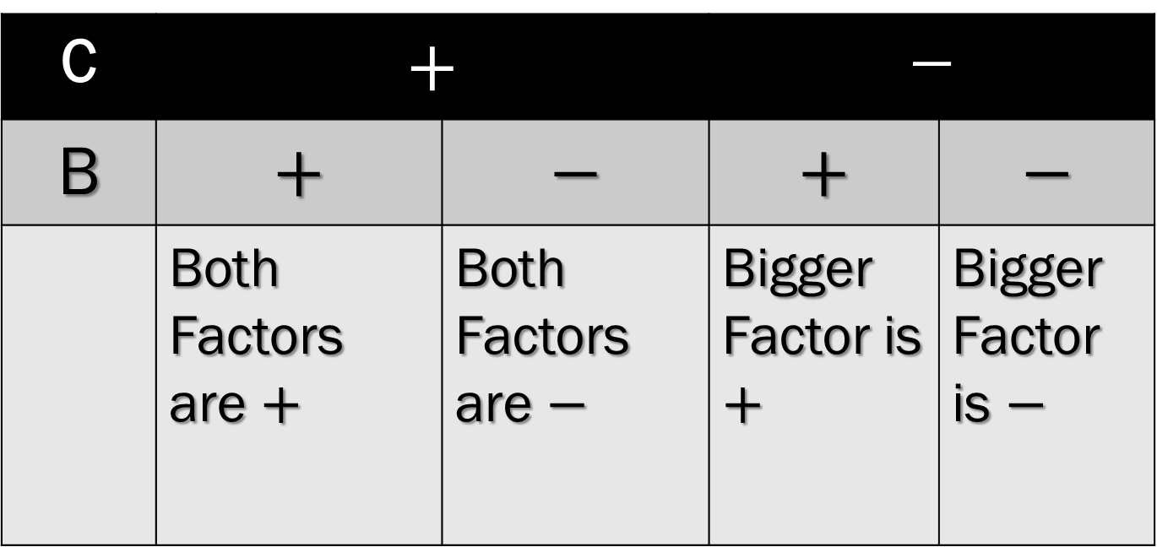
SIGN CHART
C | $$+$$ |  | $$−$$
B | $$+$$ | $$−$$ | $$+$$ | $$−$$
 | Both Factors are $+$ | Both Factors are $−$ | Bigger Factor is $+$ | Bigger Factor is $−$

Slide 3

SHORT CUT
$${Ax}^{2}+Bx+C$$
Write two sets of parenthesis,
( )( ). These will be the factors of the trinomial.
2. Think of factors of C that add up to
B. (Use Chart for Signs)

Slide 4
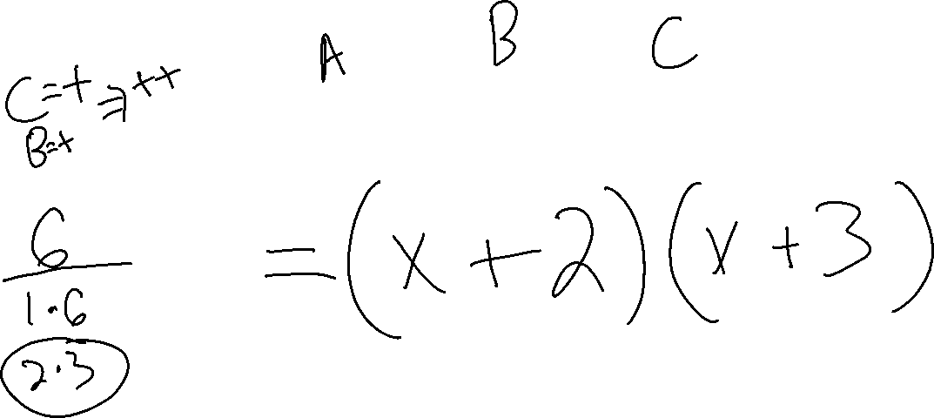
Example 1

Slide 5
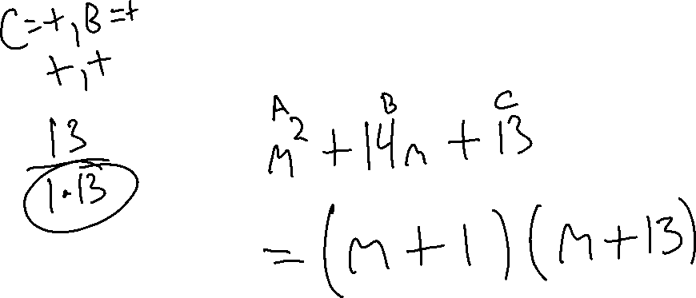
Example 2

Slide 6
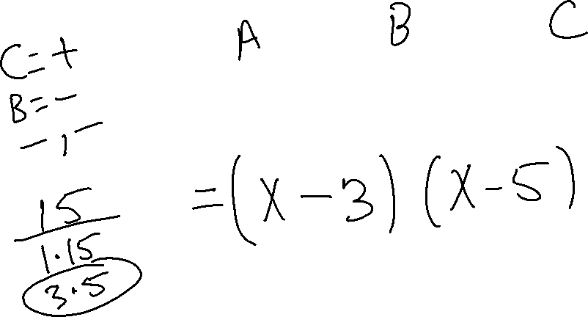
Example 3

Slide 7
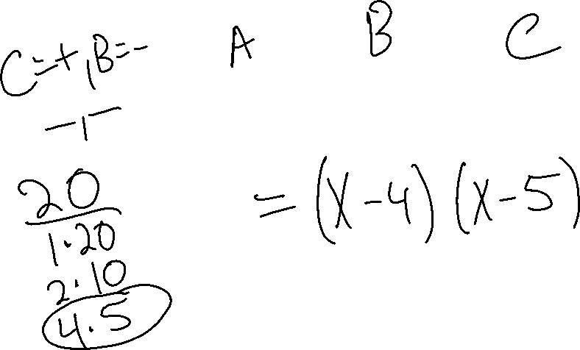
Example 4

Slide 8
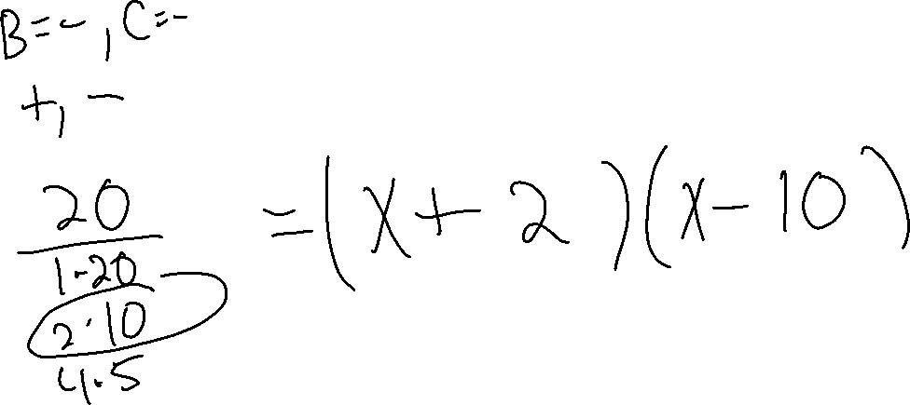
Example 5

Slide 9
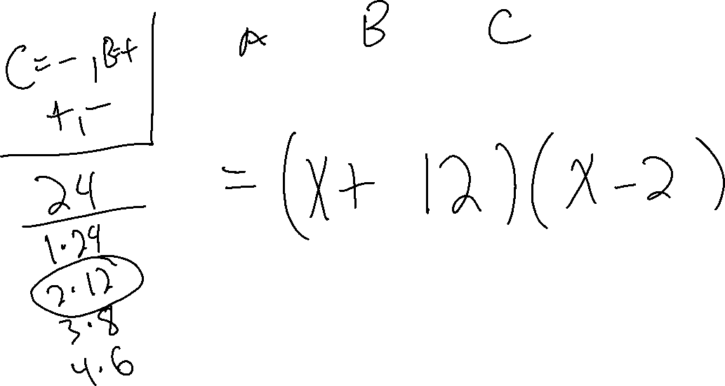
Example 6

Slide 10

Try These
${1) x}^{2}+8x+12$
${2) x}^{2}−5x+6$
${3) z}^{2}+12z−28$
${4) x}^{2}−9x−22$
${5) a}^{2}+2a+1$

